Slide 1
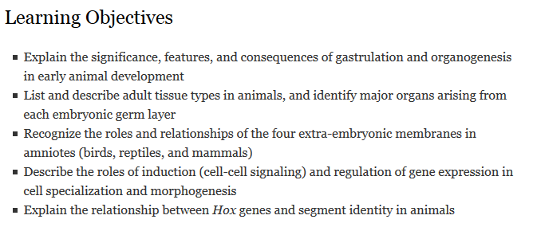
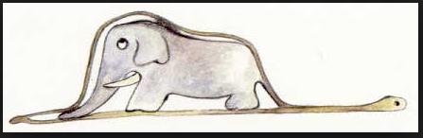
Animal Development II

Slide 2
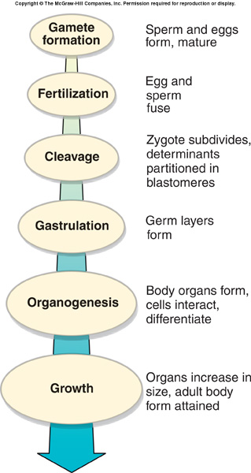
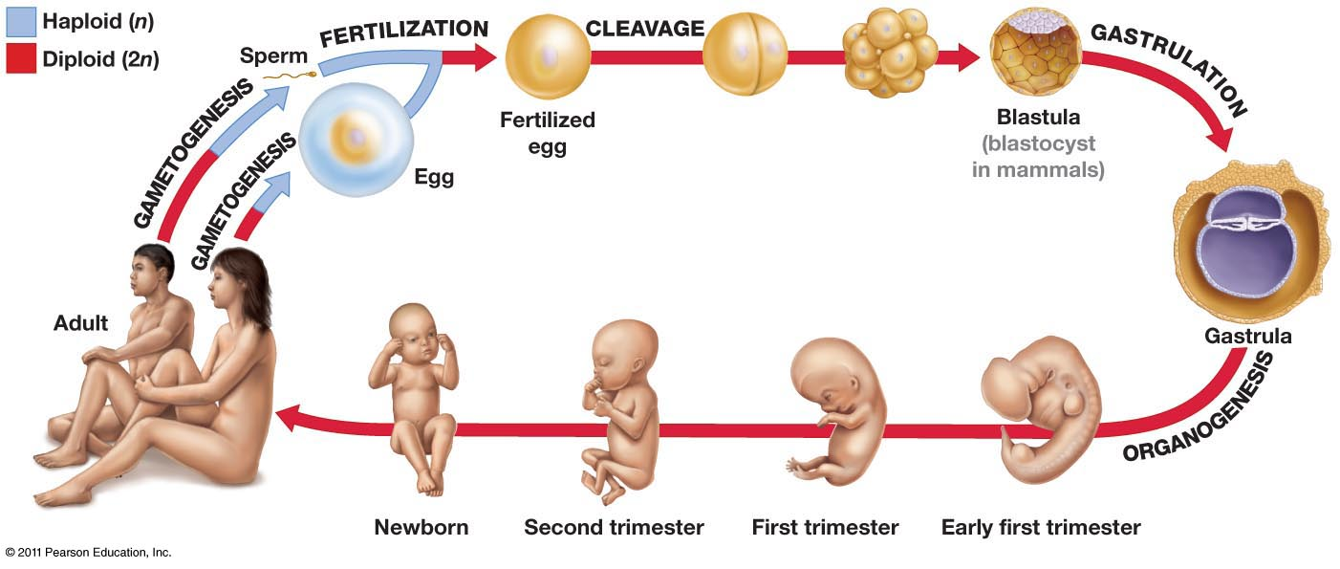
Animal Development
Four sequential stages:
Fertilization
Cleavage
Gastrulation
Organogenesis

Slide 3
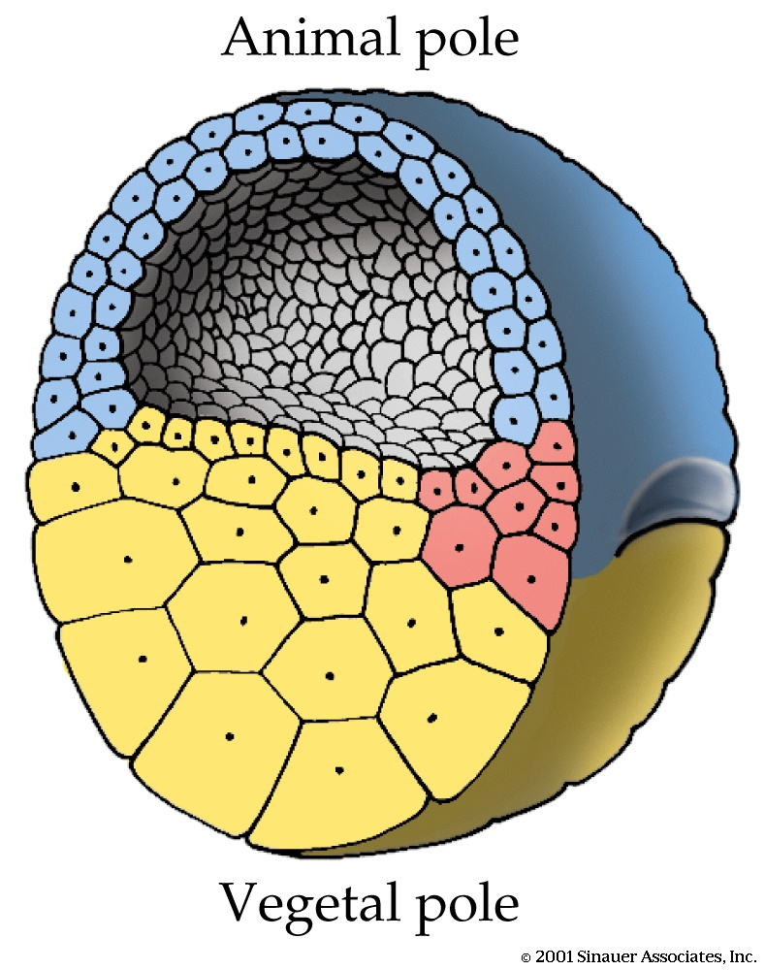
As embryo grows, certain groups of cells “fated” to become specific tissue
Ectoderm (blue): epidermis of skin, neural ectoderm will become the nervous system
Mesoderm (red): muscle, bone, kidneys, blood, gonads, connective tissue
Endoderm (yellow): lining of the gut, liver, lungs

Slide 4
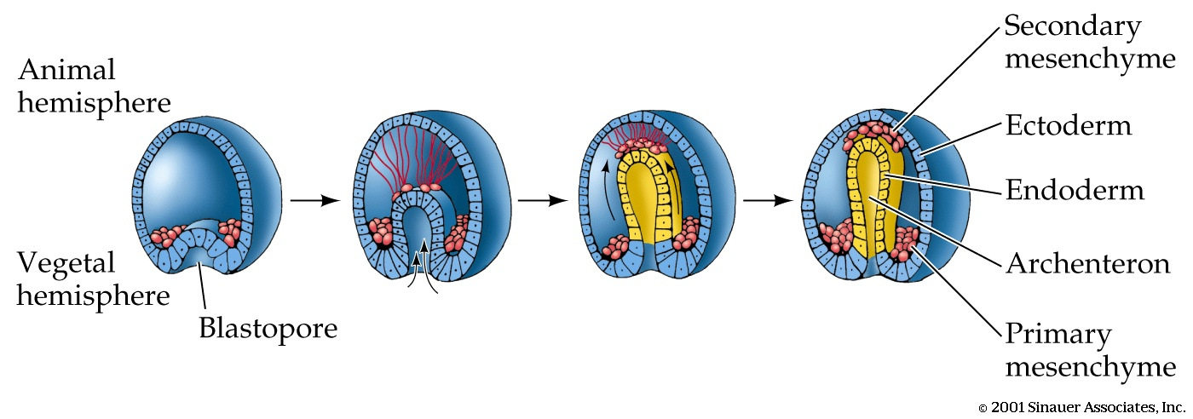
Gastrulation: Your first life crisis
Gastrulation (here in the sea urchin) establishes the basic body plan, hence it is considered the most critical point in your life (why?)

Slide 5
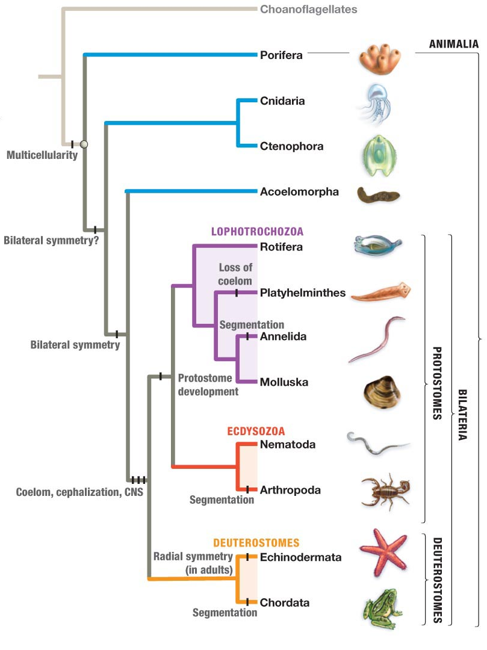
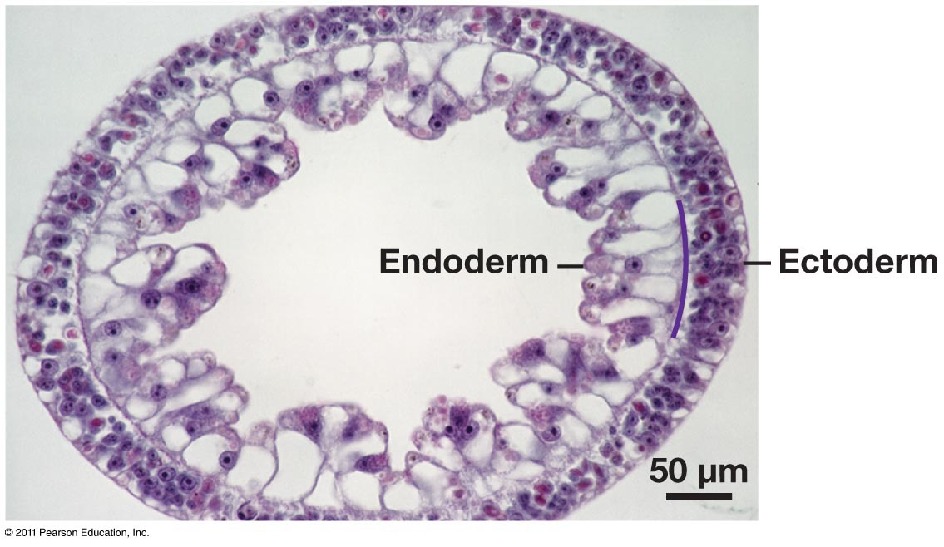
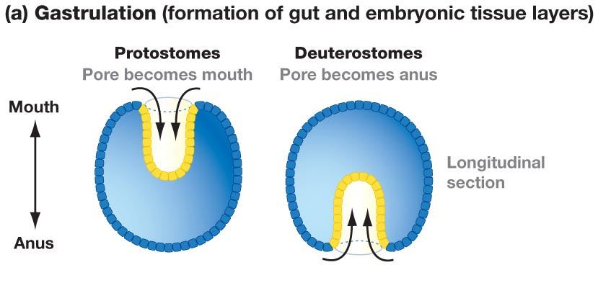
Lineage-specific differences in gastrulation
Diploblast (2 germ layers) cross-section

Slide 6
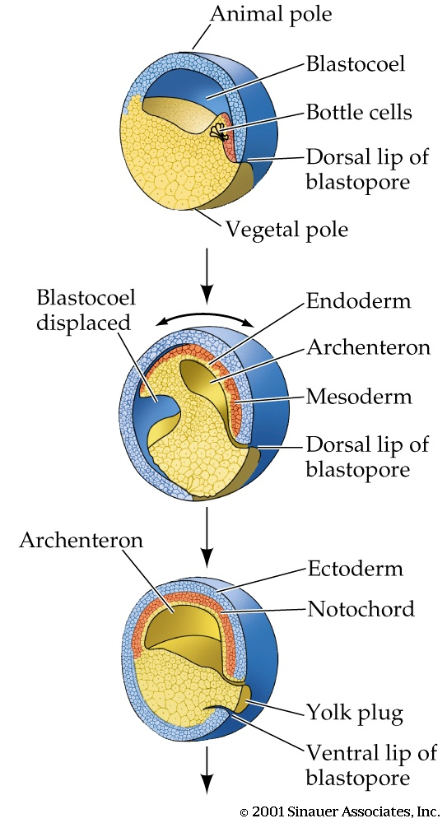
In the frog, gastrulation begins in the grey cresent, with bottle cells moving inward and defining the dorsal lip of the blastopore
Cells move inward from the outside (conveyor belt), displacing the blastocoel and creating the archenteron
The dorsal lip of the blastopore is the major organizer for subsequent development

Slide 7
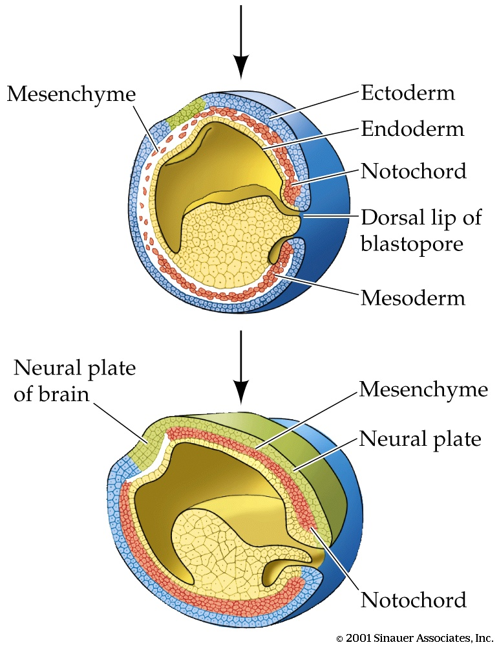
At the end of gastrulation, the major fields for development are defined:
Neural plate will fold to create the brain and spinal cord
Vertebrae will form along the notochord

Slide 8
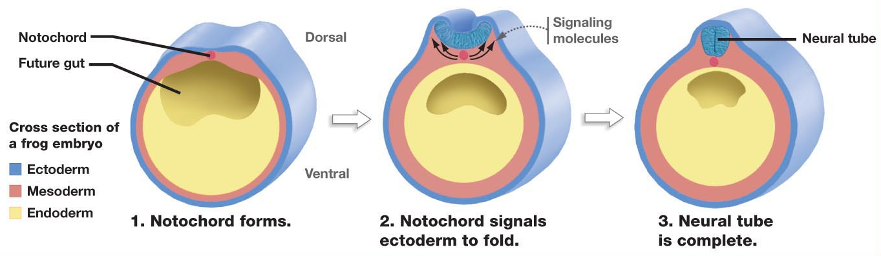
Organogenesis: Neural tube induction in a frog embryo
In vertebrates, the notochord is a transient structure which becomes part of the intervertebral discs between the vertebrae
Freeman 22.10
Notes:
Cell-cell communication (induction)
Migration
Differentiation
Proliferation

Slide 9
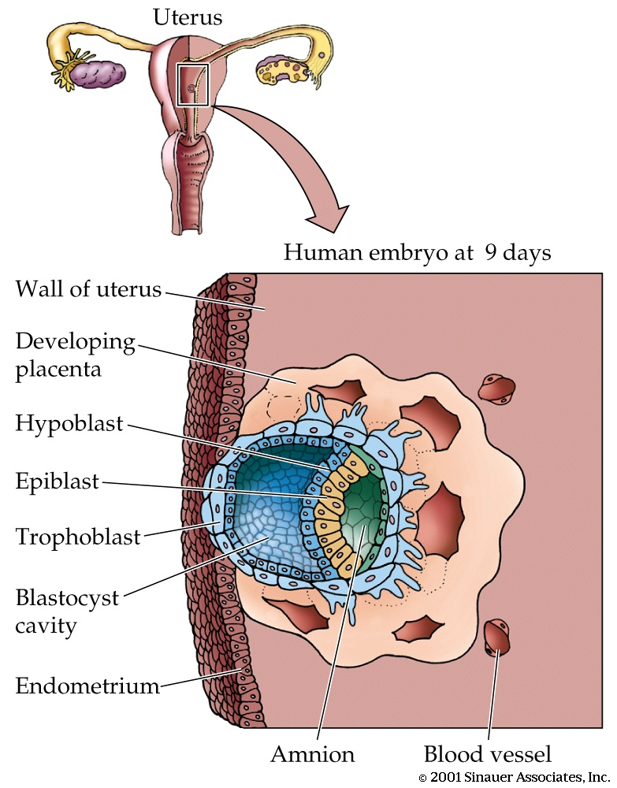
Mammals?
Even though mammal embryos lack significant amounts of yolk (in humans, energy from the egg need last only 9 days), embryonic development follows the reptile and avian pattern
The epiblast becomes the embryo, while the hypoblast forms the extraembryonic membranes necessary for exchange with the maternal circulation

Slide 10
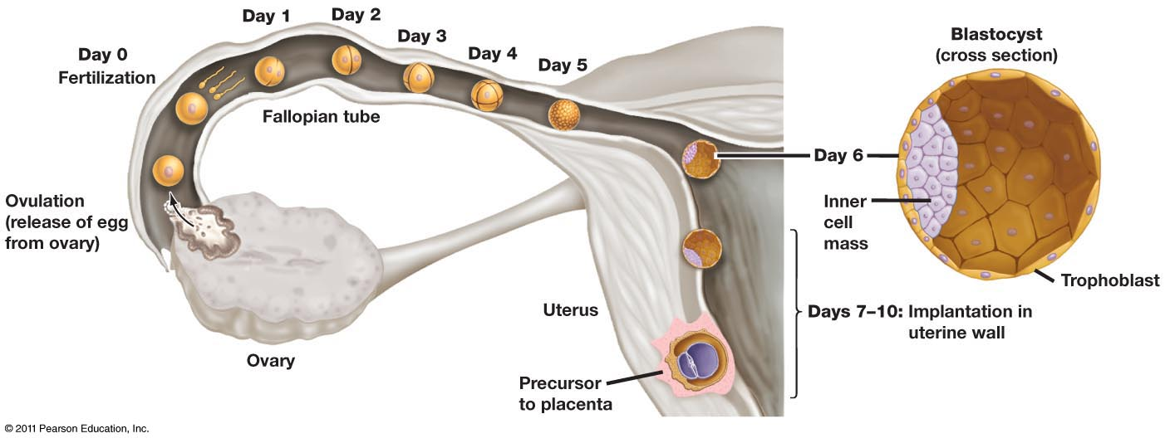
Mammals
Cleavage
Extraembryonic tissues begin forming after implantation, ~10-13 days after fertilization;
Gastrulation occurs after implantation, ~13-16 days after fertilization

Slide 11
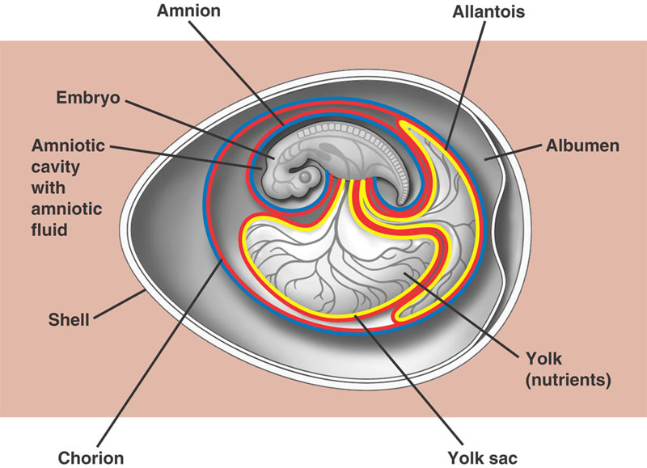
In amniotes, embryonic development is very similar to the frog, but the germ tissues extend beyond the embryo and develop into the four extra-embryonic membranes
Amnion – fluid filled cavity that provides aqueous environment and cushions against mechanical shock
Yolk sac – nutrients – blood vessels transport nutrients from yolk to embryo
Chorion – gas exchange between embryo and air
Allantois – waste disposal sac, also functions with chorion in gas exchange

Slide 12
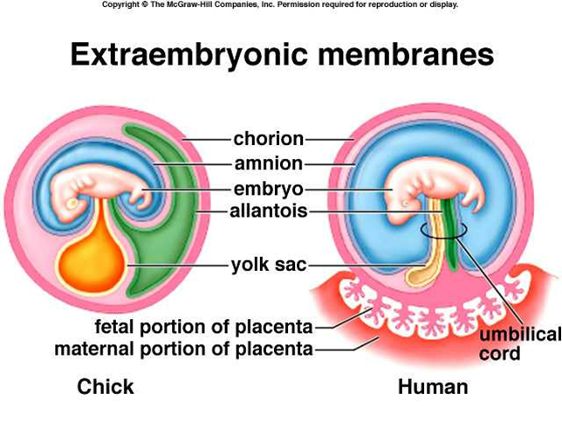
These same extra-embryonic membranes form during mammalian development, but work in conjunction with the placenta
In placental mammals, the yolk sac and allantois function as part of the umbilical cord

Slide 13
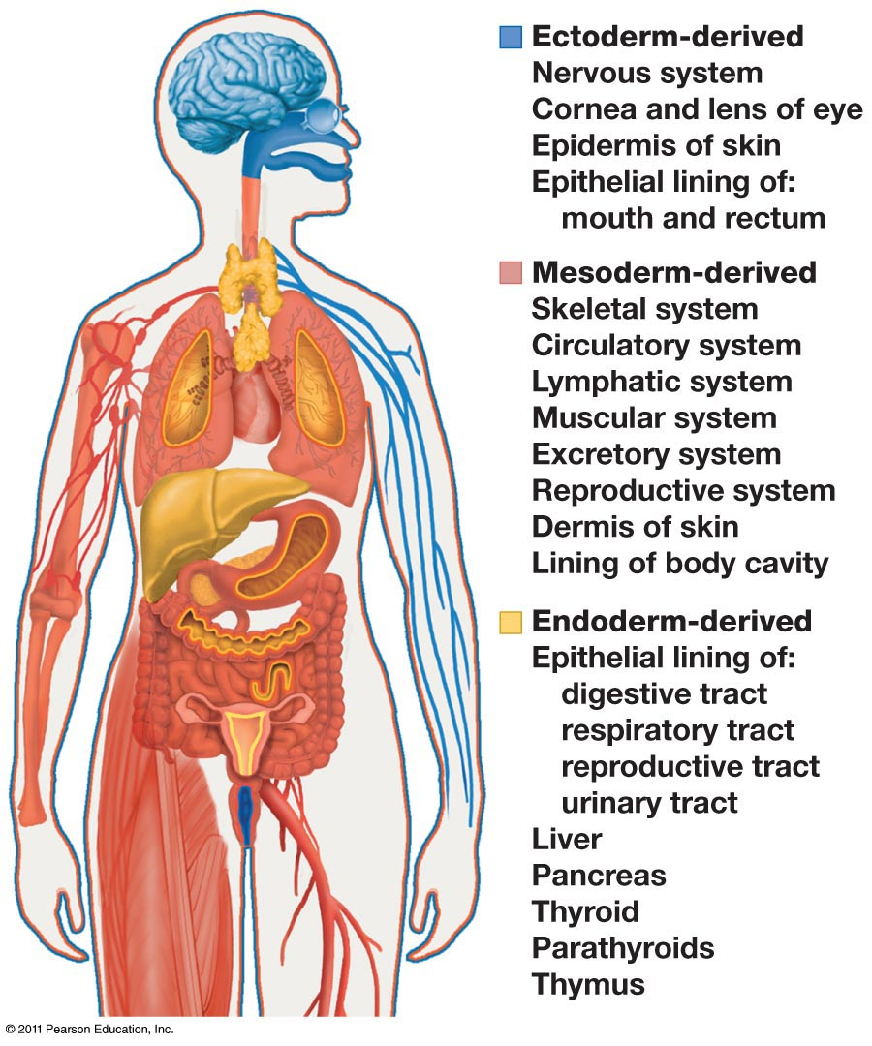
Organogenesis
Five essential developmental processes
Proliferation
Programmed cell death
Cell movement/differential expansion
Differentiation
Mediated by cell type-specific changes in gene expression
Cell-cell interactions*
Cell-cell communication (induction) ultimately mediates all other developmental processes
Freeman 22.9

Slide 14
Cell differentiation and fate mapping
Cells in a multicellular organism share the same genome
Differences in cell types is the result of differentiation, the expression of different genes
During cleavage divisions, embryonic cells become different from one another if the egg contains cytoplasmic determinants*
If the egg’s cytoplasm is heterogenous, dividing cells vary in the cytoplasmic determinants they contain
After cell asymmetries are set up, interactions among embryonic cells influence their fate, usually causing changes in gene expression
This mechanism is called induction, and is mediated by diffusible chemicals or cell-cell interactions
*Recall that mammals typically do not have cytoplasmic determinants in the egg

Slide 15
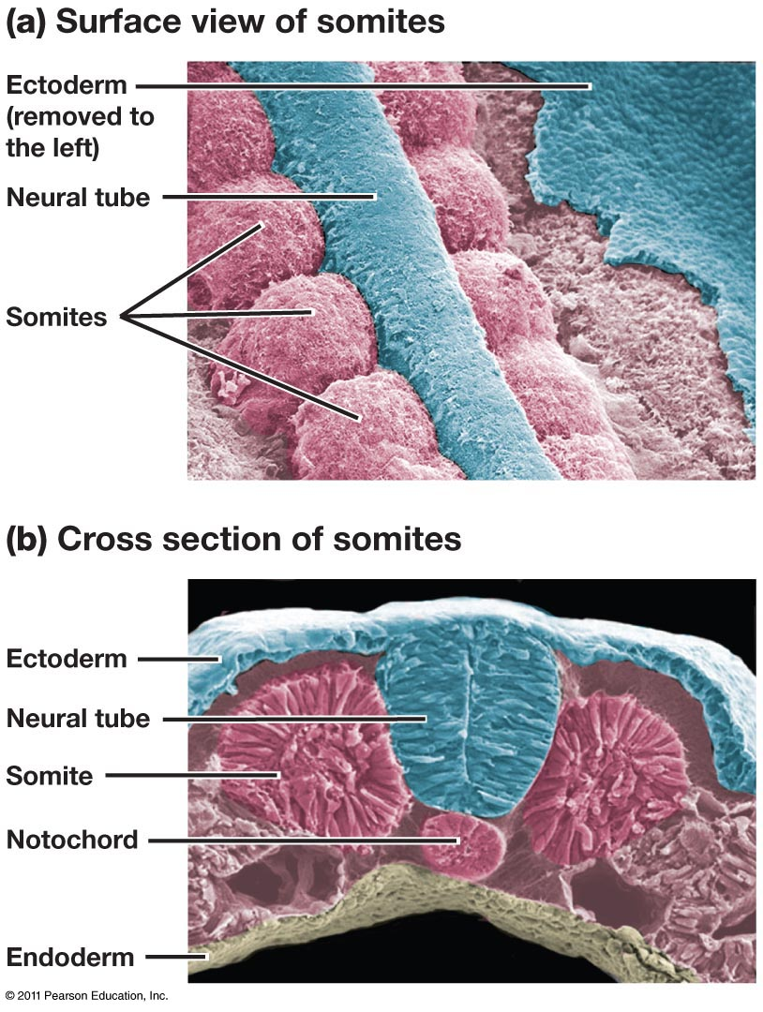
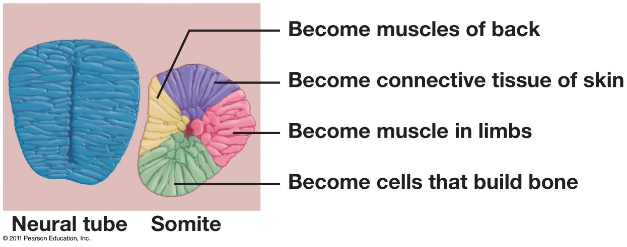
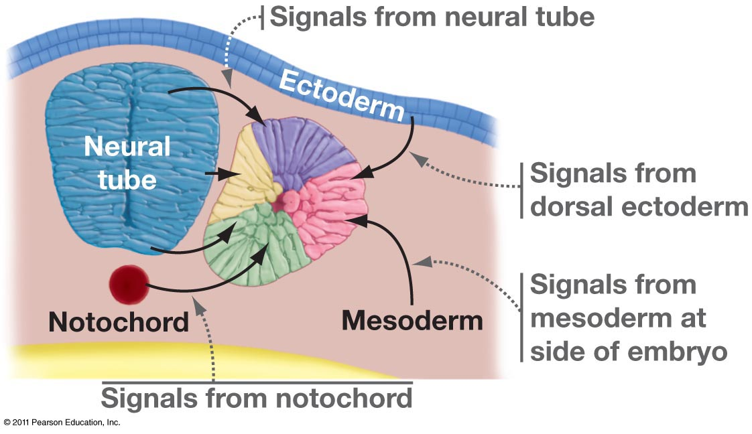
Mesodermal origin
Transient structures
Migrate to form muscles, skin connective tissue, bone
Evidence of vertebrate segmentation
Notes:
CAS #4

Slide 16
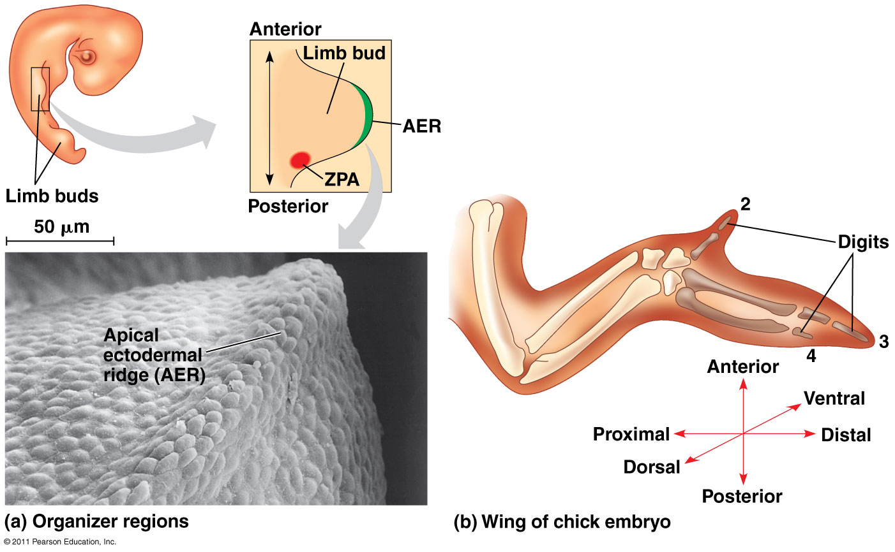
Formation of the Vertebrate Limb
Induction by AER and ZPA
AER and ZPA are patches of cells that secrete signals to surrounding cells
Pattern formation: spatial organization cells/tissues/organs within embryo
Apical ectodermal ridge (ectoderm)
Zone of polarizing activity (mesoderm)
Notes:
One limb-bud organizer region is the apical ectodermal ridge (AER)
The AER is thickened ectoderm at the bud’s tip
The second region is the zone of polarizing activity (ZPA)
The ZPA is mesodermal tissue under the ectoderm where the posterior side of the bud is attached to the body

Slide 17
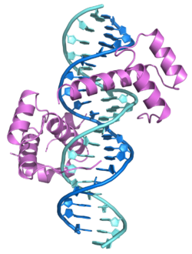
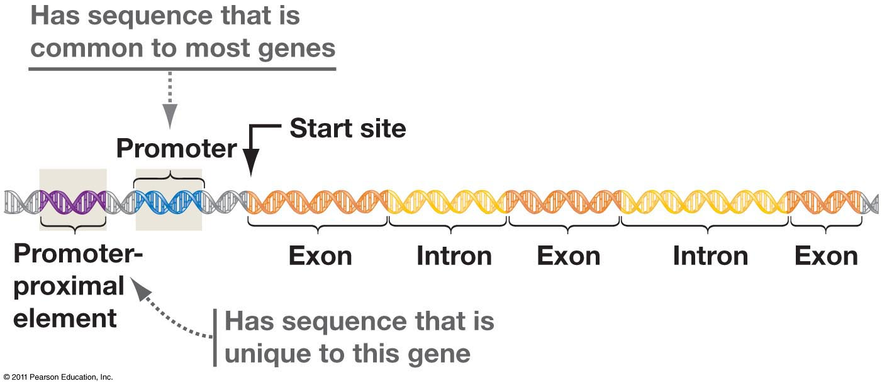
Hox genes encode transcription factors
Regulate gene expression by binding to DNA control regions (promoters, enhancers)
Hox genes contain a highly conserved amino acid sequence, the homeobox
Control segment identity along A/P axis
All animal phyla possess a set of Hox genes (except sponges)
The number of genes & sets of complexes vary
Plant development relies on Mads-box genes
Function similarly to Hox genes, but they are not evolutionarily related genes
RNA polymerase
Transcription
factor
Regulatory element

Slide 18
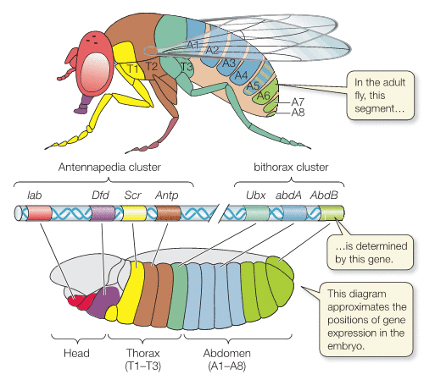
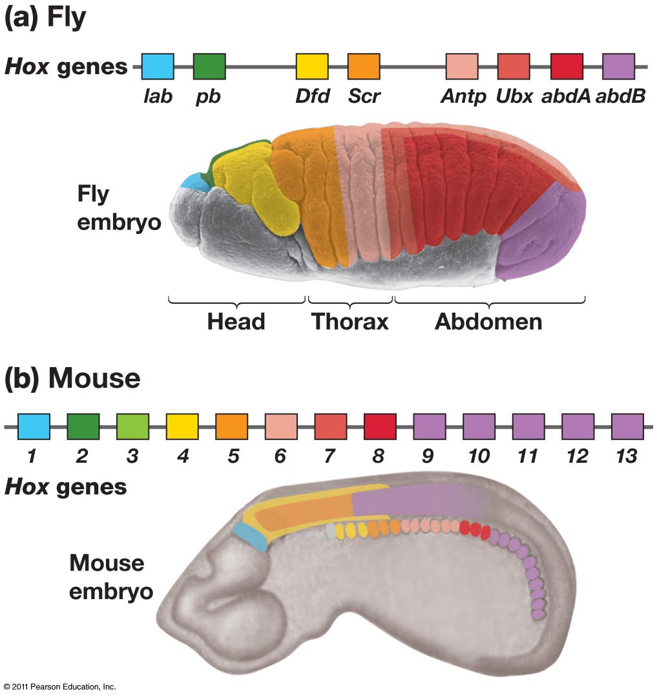
Hox gene expression patterns establish segment ‘identity’
Color coding = where in the embryo the particular Hox gene is expressed (transcribed and translated)
Freeman 21.10
Notes:
What does the color coding on this diagram mean?

Slide 19
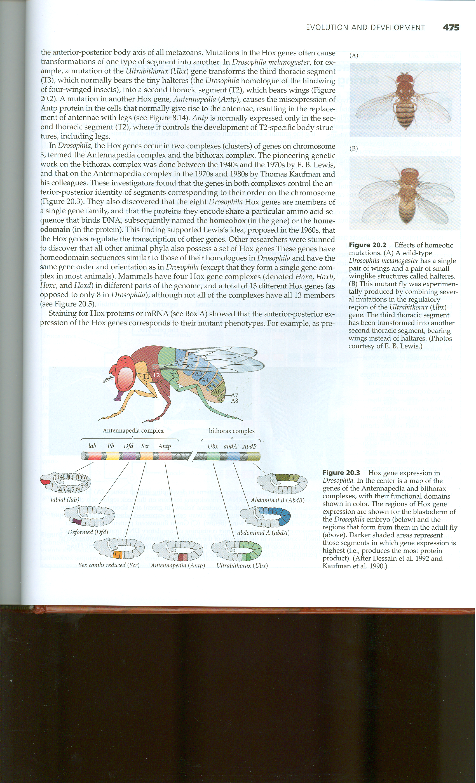
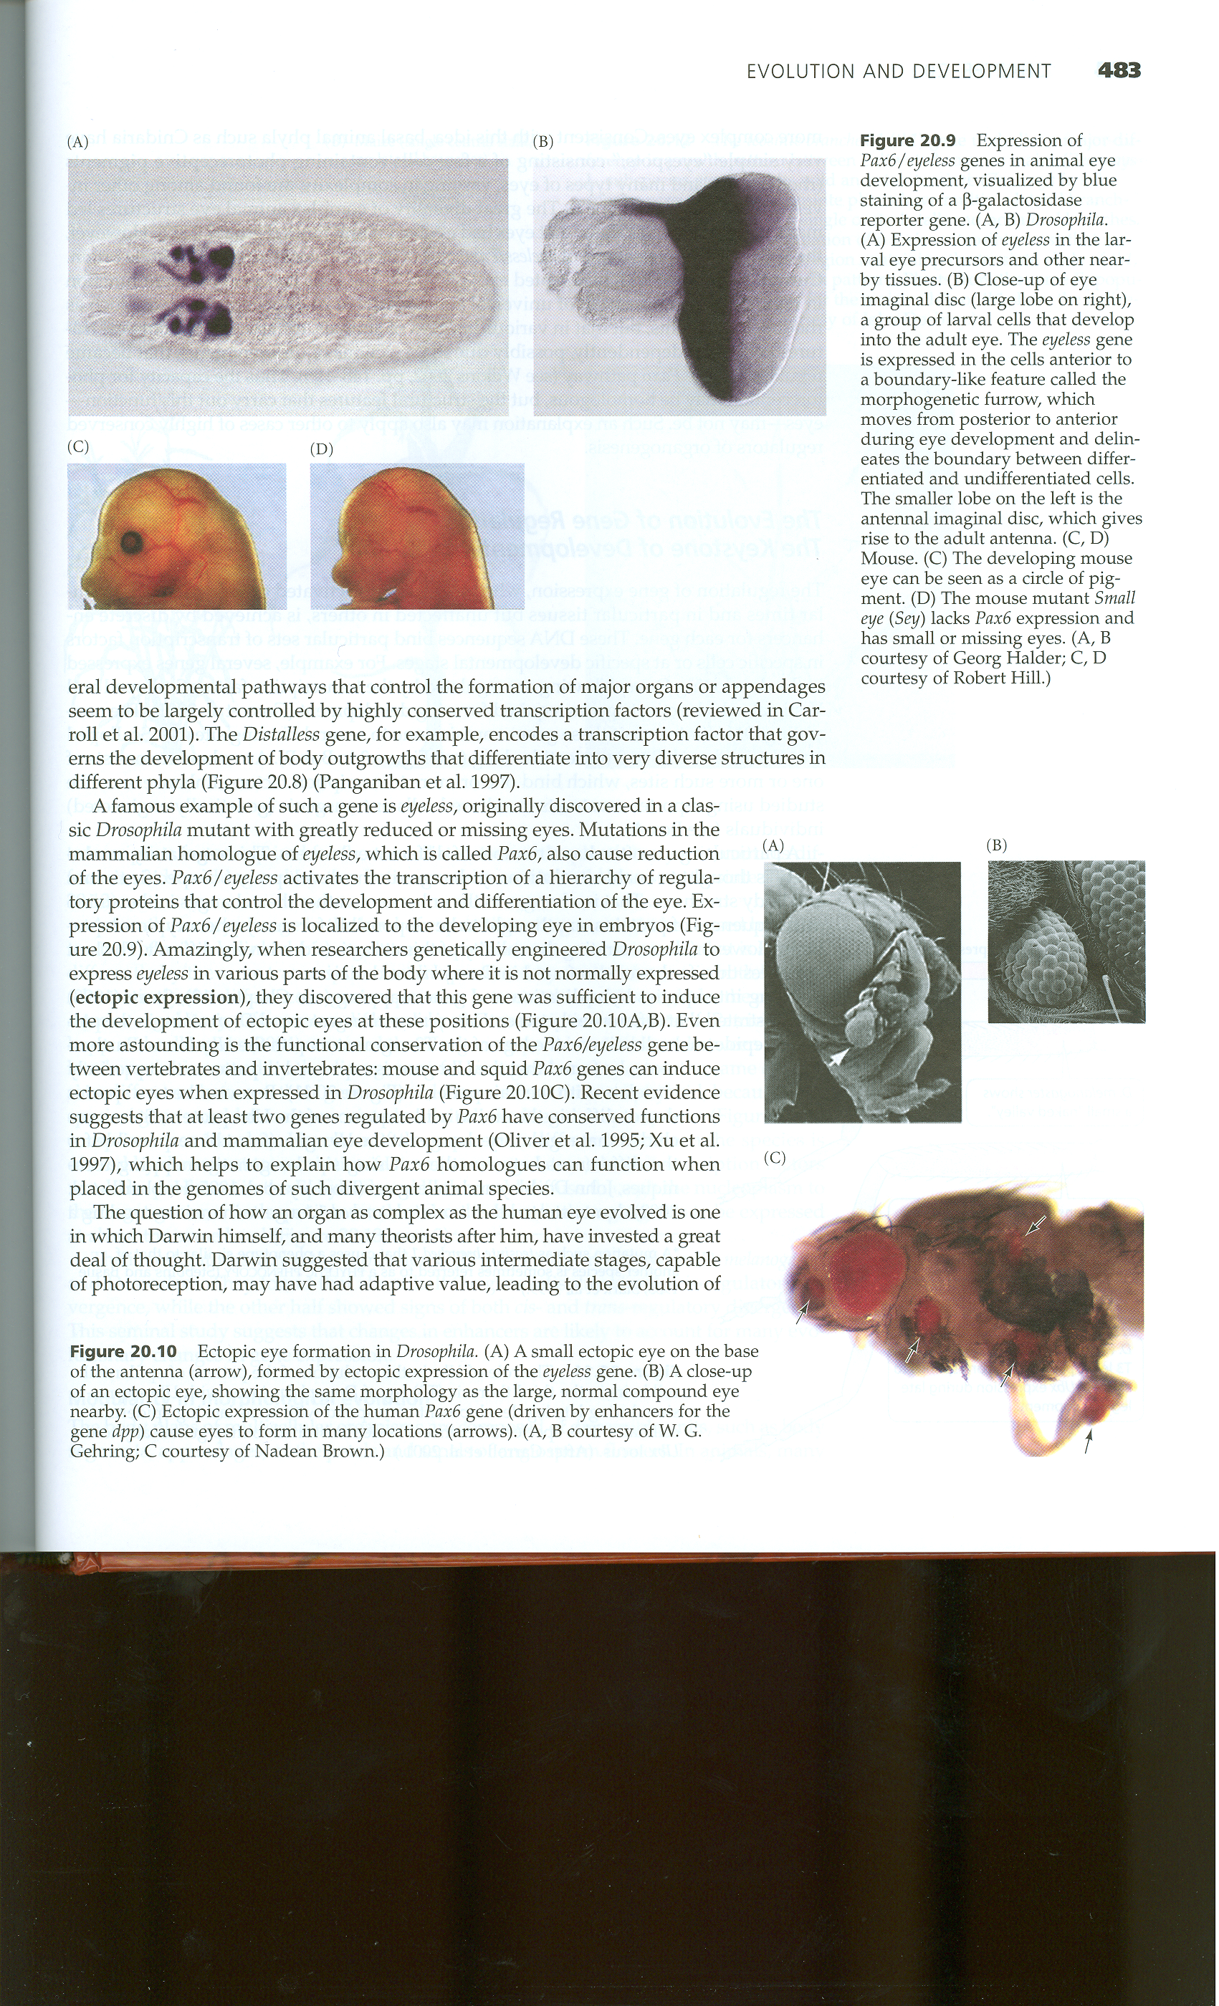
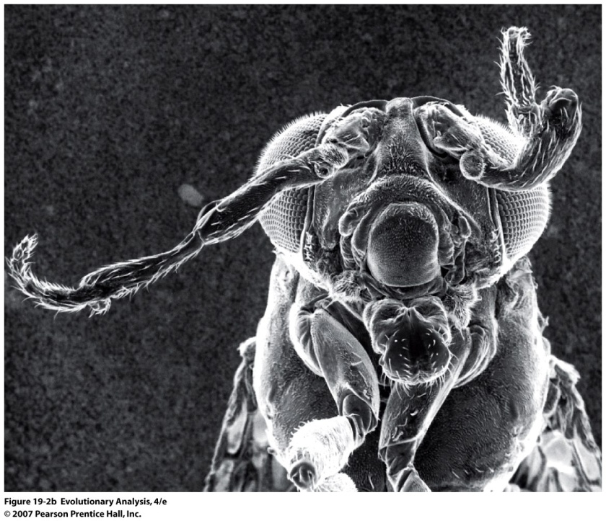
Mis-expression of Hox genes
By altering Hox gene expression, researchers observe how segments take on new identities
Misexpression of Ubx
Misexpression of Antp
Expression of human Pax6 gene
Futuyma 2005

Slide 20
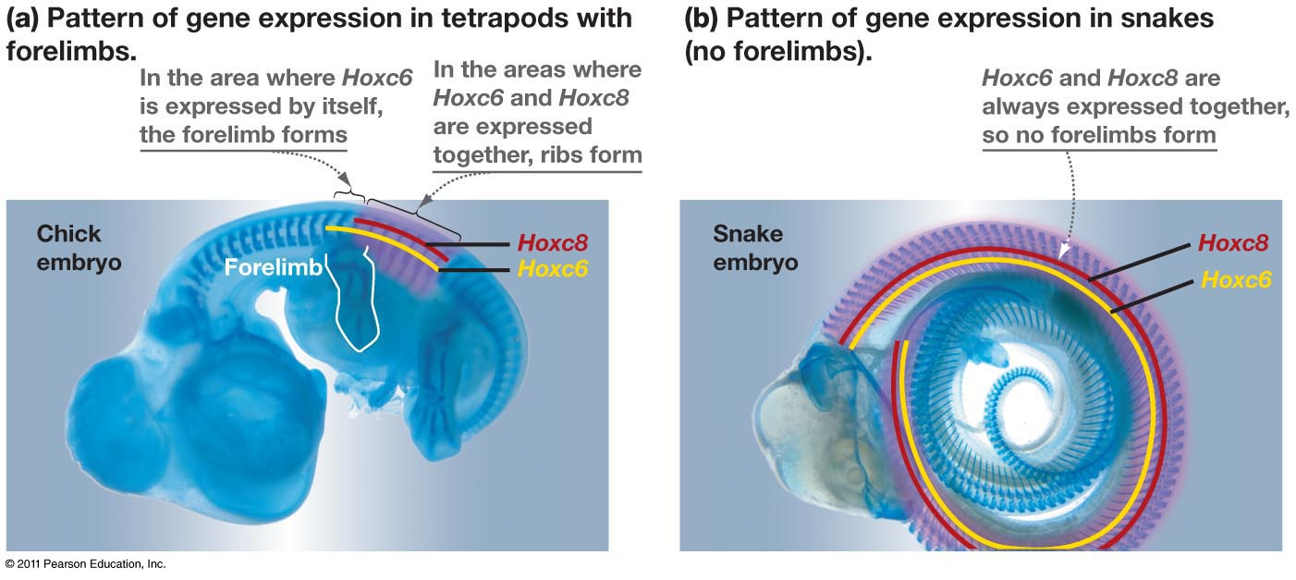
The role of Hox genes in segment identity
How might these two genes regulate development in limbless tetrapods?

Slide 21
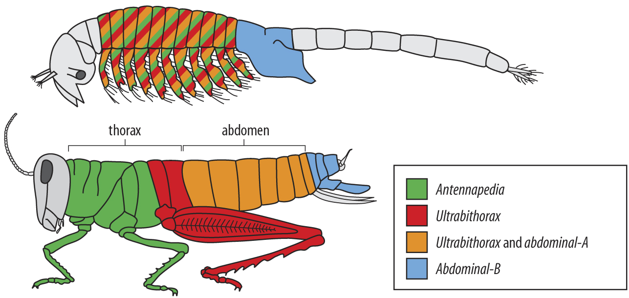
Combinatorial Hox gene expression
Freeman 21.12
crustacean
insect
Notes:
http://www.usatoday.com/tech/columnist/aprilholladay/2005-06-10-wonderquest_x.htm

Slide 22
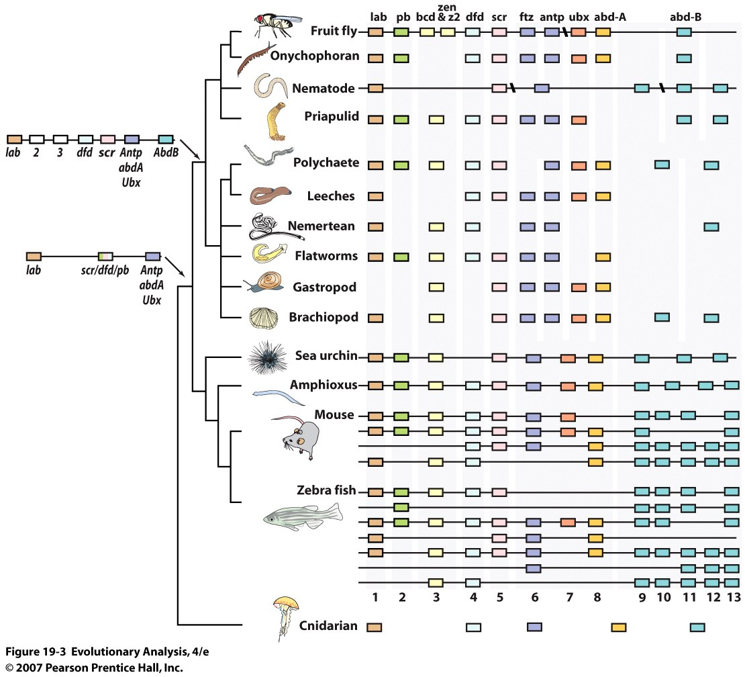
Depicting diversity of animal Hox complexes
Protostomes
Bilateria
Deuterostomes
Duplication of Hox cluster occurred >2x in vertebrates
Notes:
Reorganization of Hox genes into cluster occurred in common ancestor to Bilateria
Duplication of Hox cluster provided raw material for natural selection
Good, but not absolute, correlation between speciation events and increasing numbers of Hox genes

